Slide 1

Machine Learning
ICT-4261
By-
Dr. Jesmin Akhter
Professor
Institute of Information Technology
Jahangirnagar University

Slide 2
Contents
The course will mainly cover the following topics:
A Gentle Introduction to Machine Learning
Logistic Regression
Naive Bayes
Support Vector Machines
Decision Trees and Ensemble Learning
Clustering Fundamentals
Hierarchical Clustering
Neural Networks and Deep Learning
Unsupervised Learning

Slide 3
Outline
The Bayesian “Decision”
The “Naïve Bayesian” Assumption
Types of Naïve Bayes
Laplace Correction

Slide 4
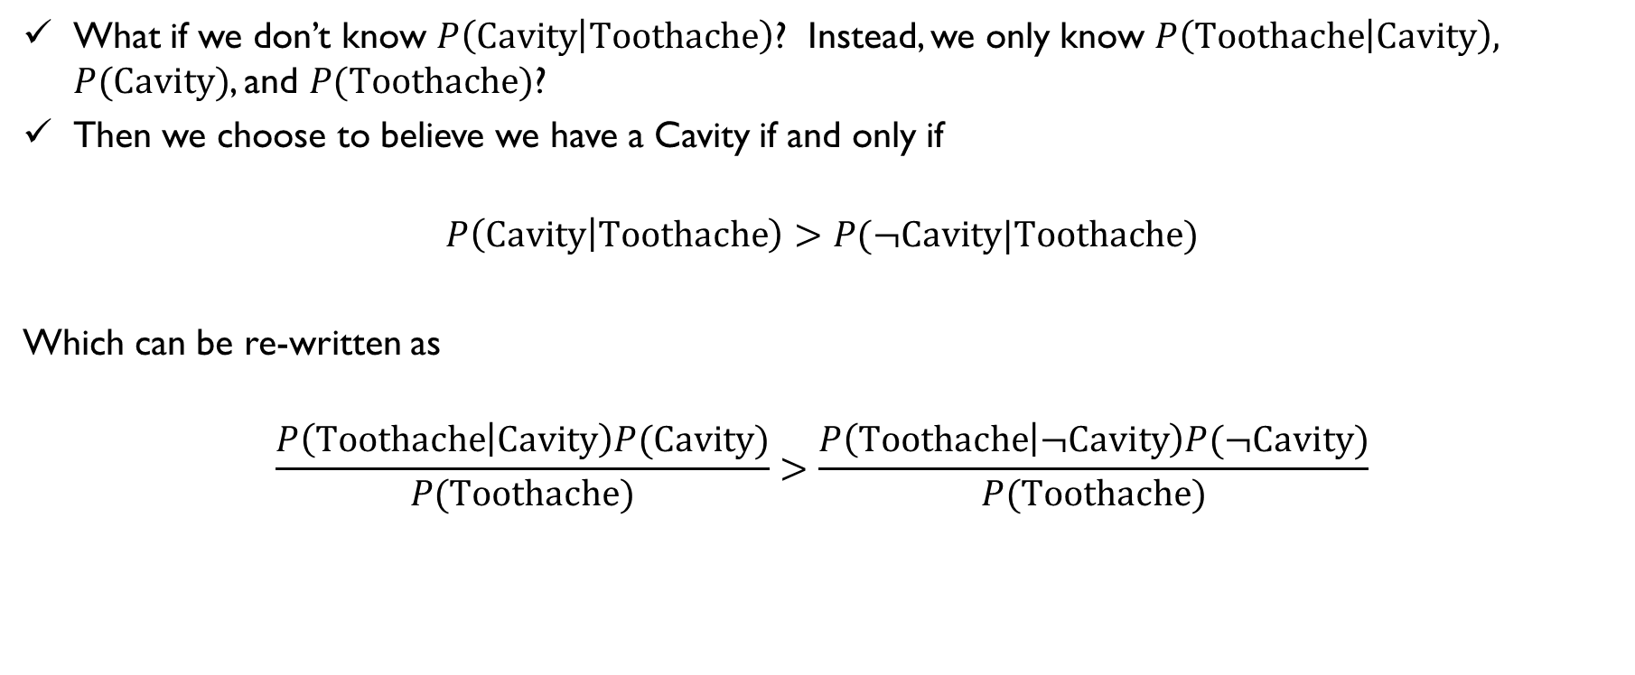
Bayesian Decisions
What if we don’t know $P\left(Cavity | Toothache\right)$? Instead, we only know $P\left(Toothache | Cavity\right),$ $P(Cavity)$, and $P(Toothache)$?
Then we choose to believe we have a Cavity if and only if
$$P\left(Cavity | Toothache\right)>P(¬Cavity|Toothache)$$
Which can be re-written as
$$\frac{P\left(Toothache | Cavity\right)P(Cavity)}{P(Toothache)}>\frac{P\left(Toothache | ¬Cavity\right)P(¬Cavity)}{P(Toothache)}$$

Slide 5
Naive Bayes Classifier?
Naive Bayes is a statistical classification technique based on Bayes Theorem. It is one of the simplest supervised learning algorithms.
Naive Bayes classifier is the fast, accurate and reliable algorithm.
Naive Bayes classifiers have high accuracy and speed on large datasets.
Naive Bayes classifier assumes that the effect of a particular feature in a class is independent of other features.
For example, a loan applicant is desirable or not depending on his/her income, previous loan and transaction history, age, and location. Even if these features are interdependent, these features are still considered independently.

Slide 6
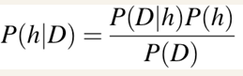
Naive Bayes Classifier?
P(h): the probability of hypothesis h being true (regardless of the data). This is known as the prior probability of h.
P(D): the probability of the data (regardless of the hypothesis). This is known as the prior probability (evidence distribution).
P(h|D): the probability of hypothesis h given the data D. This is known as posterior probability.
P(D|h): the probability of data d given that the hypothesis h was true. This is known as posterior probability (likelihood).

Slide 7
How Naive Bayes classifier works?
Let’s understand the working of Naive Bayes through an example.
Given an example of weather conditions and playing sports.
You need to calculate the probability of playing sports.
Now, you need to classify whether players will play or not, based on the weather condition.
First Approach (In case of a single feature)
Naive Bayes classifier calculates the probability of an event in the following steps:
Step 1: Calculate the prior probability for given class labels
Step 2: Find Likelihood probability with each attribute for each class
Step 3: Put these value in Bayes Formula and calculate posterior probability.
Step 4: See which class has a higher probability, given the input belongs to the higher probability class.

Slide 8
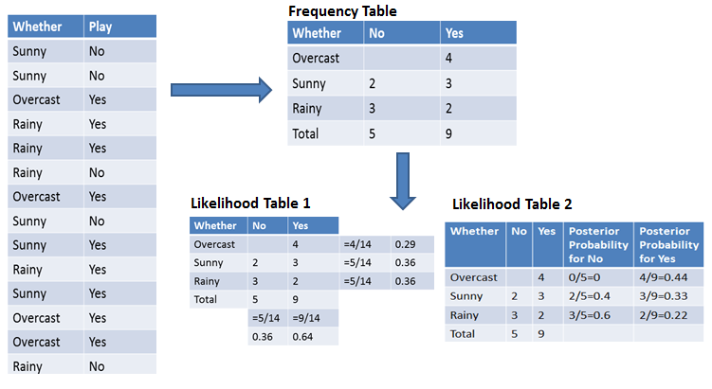
For simplifying prior and posterior probability calculation
you can use the two tables frequency and likelihood tables.
Both of these tables will help you to calculate the prior and posterior probability.
The Frequency table contains the occurrence of labels for all features.
There are two likelihood tables.
Likelihood Table 1 is showing prior probabilities of labels and
Likelihood Table 2 is showing the posterior prob

Slide 9
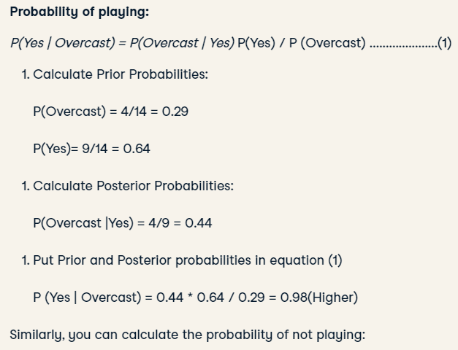
Now suppose you want to calculate the probability of playing when the weather is overcast.

Slide 10
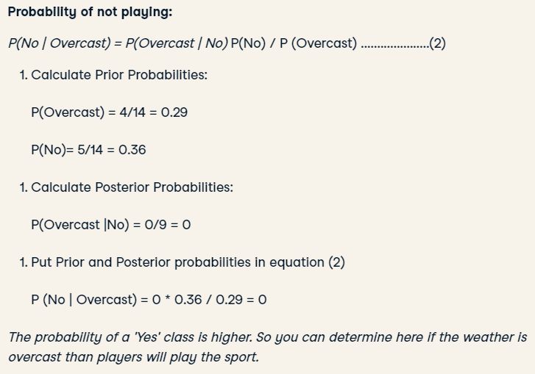

Slide 11
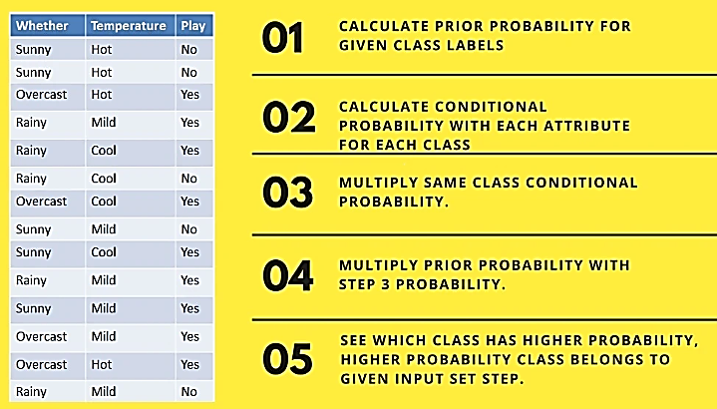
Second Approach (In case of multiple features)

Slide 12
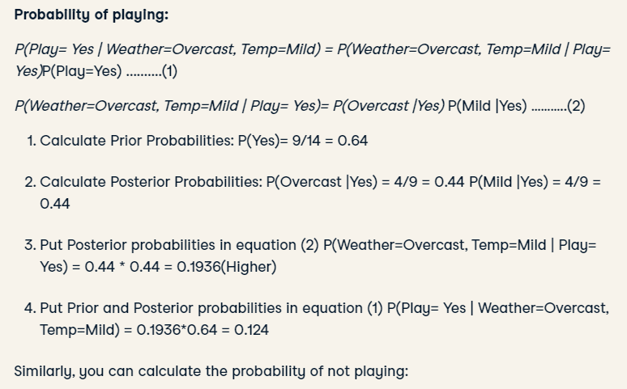
Now suppose you want to calculate the probability of playing when the weather is overcast, and the temperature is mild.

Slide 13
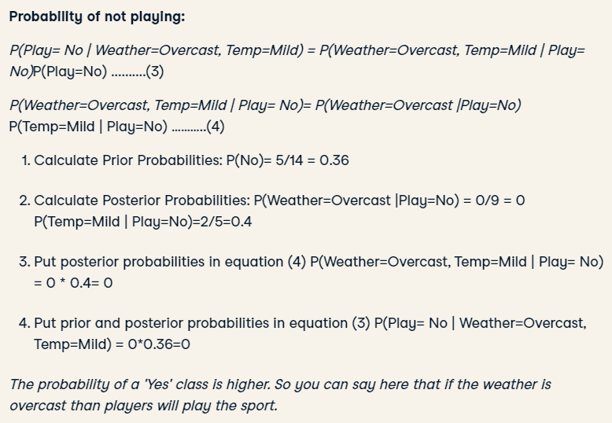

Slide 14
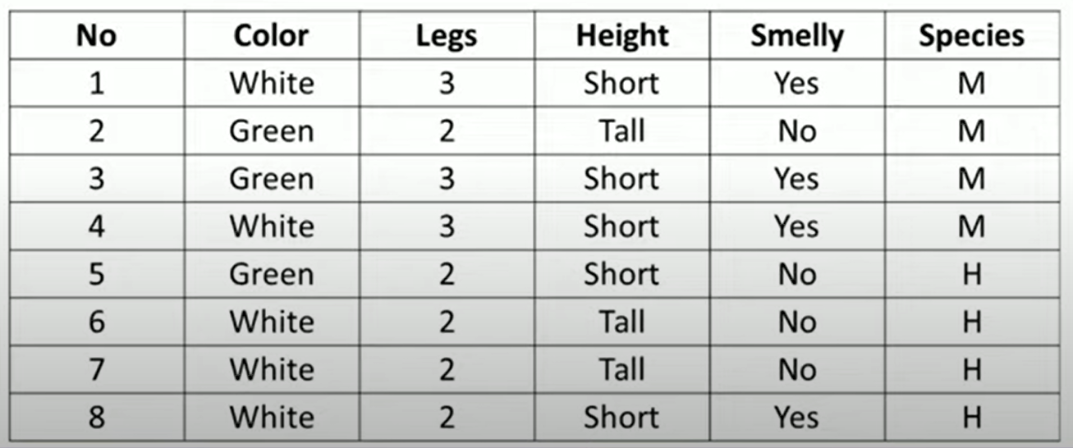
Estimate the probability values for the new instances (Color=green, Legs=2, Height=Tall and Smelly=No)

Slide 15
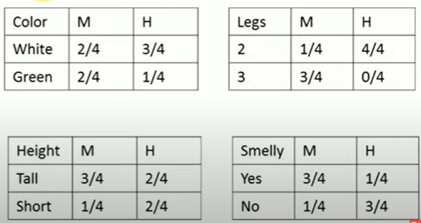
1. Calculate prior probability
P(M)=4/8= 0.5
P(H)= 4/8= 0.5
1. Calculate Conditional probability

Slide 16
Now calculate probability values for the new instances (Color=green, Legs=2, Height=Tall and Smelly=No)
P(M|color=green, Legs=2, Height=Tall and Smelly=No)
= P(M) * P(color=green|M) *
P(Legs=2 |M) *
P(Height=Tall |M) *
P(Smelly=No |M)
= 0.5 * 0.5 * .25 * ¾ * .25
=0.0117

Slide 17
P(H|color=green, Legs=2, Height=Tall and Smelly=No)
= P(H) * P(color=green|H) *
P(Legs=2 |H) *
P(Height=Tall |H) *
P(Smelly=No |H)
= 0.5 * 0.25 * 1 * .5 * ¾
=0.047
Since p(H|new instance)> p(M|new instance)
So the new instance belongs to Species H

Slide 18
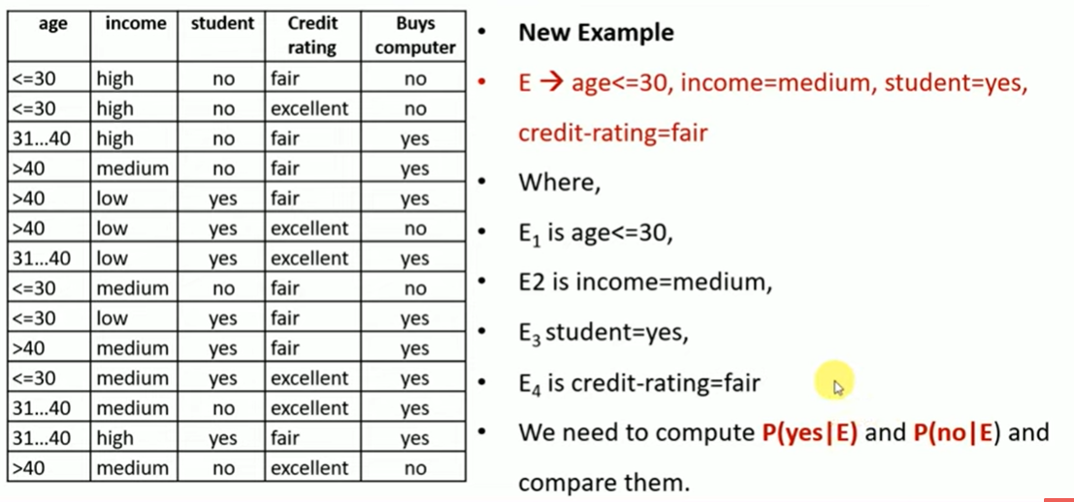

Slide 19
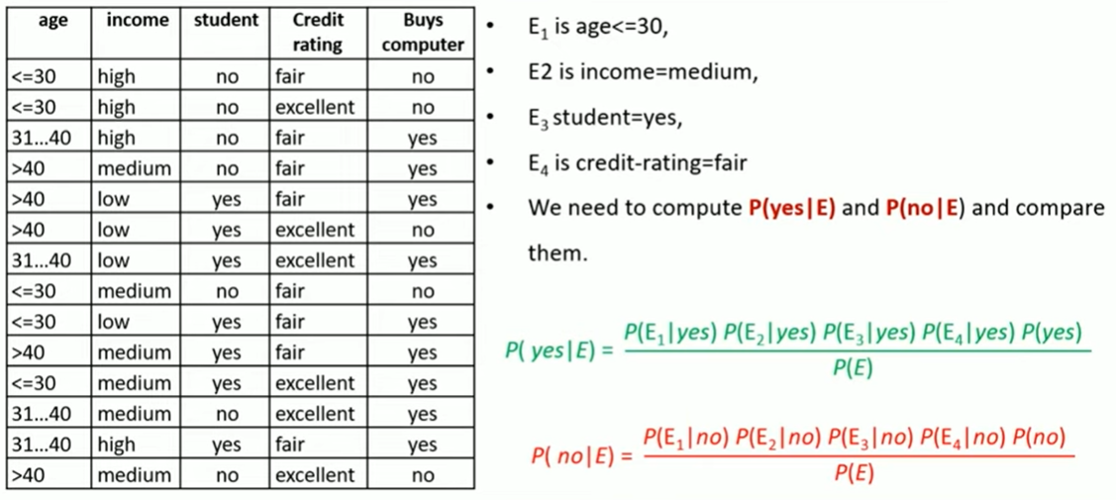

Slide 20
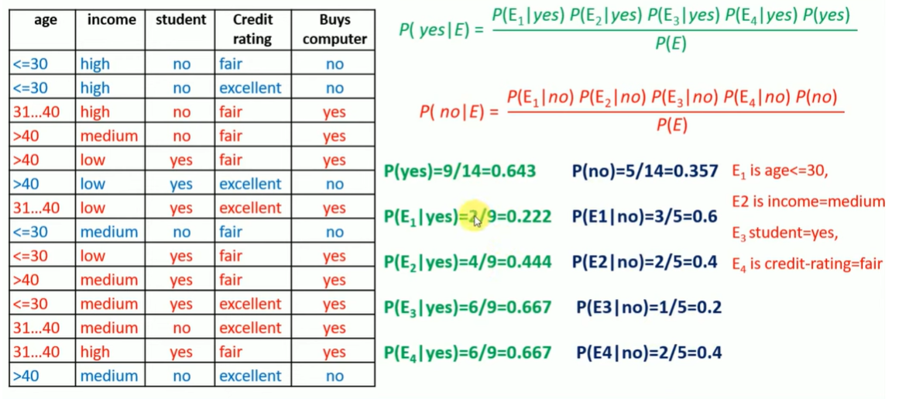

Slide 21
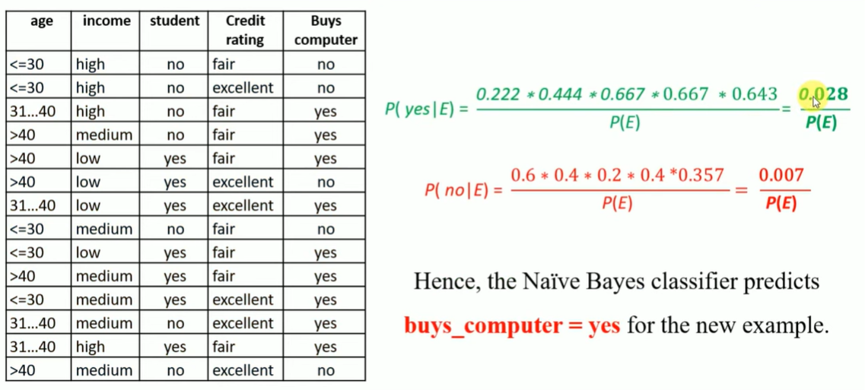

Slide 22
Tabular representation of an example dataset
 | Outlook | Temperature | Humidity | Windy | Play Golf
0 | Rainy | Hot | High | False | No
1 | Rainy | Hot | High | True | No
2 | Overcast | Hot | High | False | Yes
3 | Sunny | Mild | High | False | Yes
4 | Sunny | Cool | Normal | False | Yes
5 | Sunny | Cool | Normal | True | No
6 | Overcast | Cool | Normal | True | Yes
7 | Rainy | Mild | High | False | No
8 | Rainy | Cool | Normal | False | Yes
9 | Sunny | Mild | Normal | False | Yes
10 | Rainy | Mild | Normal | True | Yes
11 | Overcast | Mild | High | True | Yes
12 | Overcast | Hot | Normal | False | Yes
13 | Sunny | Mild | High | True | No
The dataset is divided into two parts, namely, feature matrix and the response vector.
Feature matrix contains all the vectors(rows) of dataset in which each vector consists of the value of dependent features. In the dataset, features are ‘Outlook’, ‘Temperature’, ‘Humidity’ and ‘Windy’.
Response vector contains the value of class variable(prediction or output) for each row of feature matrix. In the dataset, the class variable name is ‘Play golf’

Slide 23
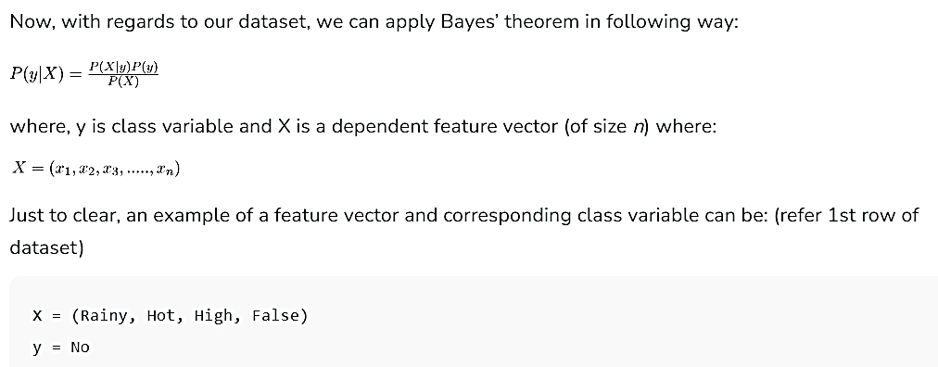
With relation to our dataset, this concept can be understood as:
We assume that no pair of features are dependent. For example, the temperature being ‘Hot’ has nothing to do with the humidity or the outlook being ‘Rainy’ has no effect on the winds. Hence, the features are assumed to be independent.
Secondly, each feature is given the same weight(or importance). For example, knowing only temperature and humidity alone can’t predict the outcome accurately. None of the attributes is irrelevant and assumed to be contributing equally to the outcome.

Slide 24
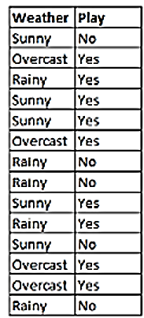
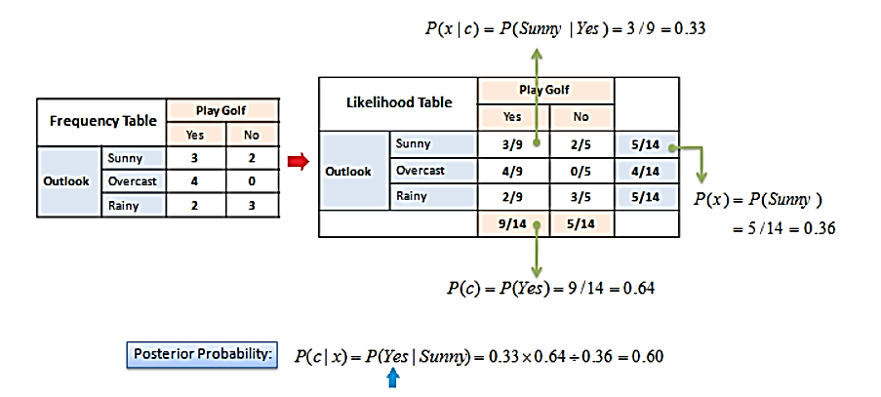
Naive assumption Example 1
The posterior probability can be calculated by first, constructing a frequency table for each attribute against the target. Then, transforming the frequency tables to likelihood tables and finally use the Naive Bayesian equation to calculate the posterior probability for each class. The class with the highest posterior probability is the outcome of prediction.
Problem: Players will play if the weather is sunny. Is this statement correct?

Slide 25
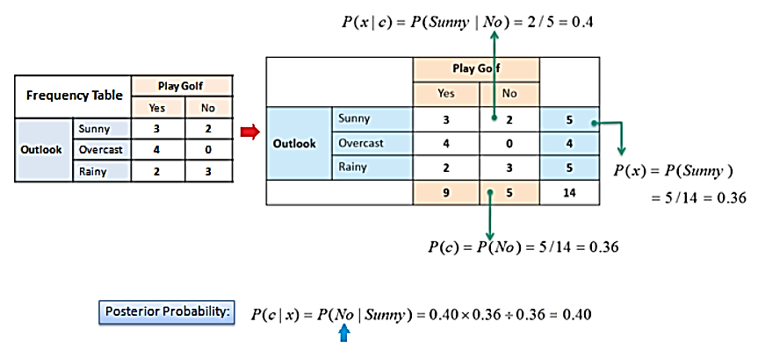
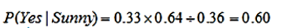
Naive assumption
which has higher probability.
So the statement is correct

Slide 26
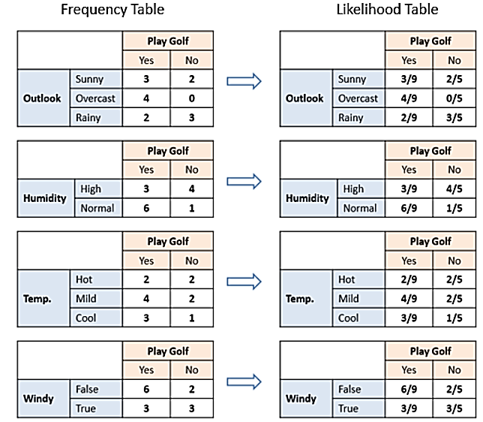
Naive assumption
 | Outlook | Temperature | Humidity | Windy | Play Golf
0 | Rainy | Hot | High | False | No
1 | Rainy | Hot | High | True | No
2 | Overcast | Hot | High | False | Yes
3 | Sunny | Mild | High | False | Yes
4 | Sunny | Cool | Normal | False | Yes
5 | Sunny | Cool | Normal | True | No
6 | Overcast | Cool | Normal | True | Yes
7 | Rainy | Mild | High | False | No
8 | Rainy | Cool | Normal | False | Yes
9 | Sunny | Mild | Normal | False | Yes
10 | Rainy | Mild | Normal | True | Yes
11 | Overcast | Mild | High | True | Yes
12 | Overcast | Hot | Normal | False | Yes
13 | Sunny | Mild | High | True | No
The likelihood tables for all four predictors.

Slide 27
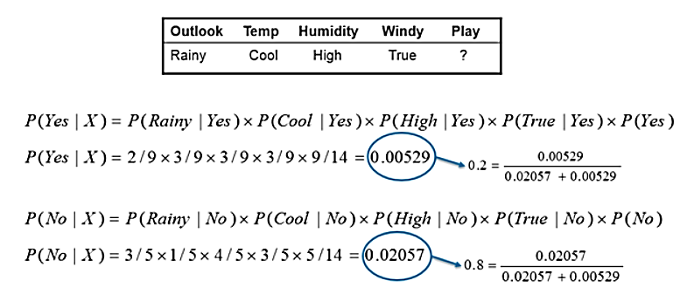
Naive assumption Example 2
In this example we have 4 inputs (predictors). The final posterior probabilities can be standardized between 0 and 1.
which has higher probability.
So not going to play

Slide 28
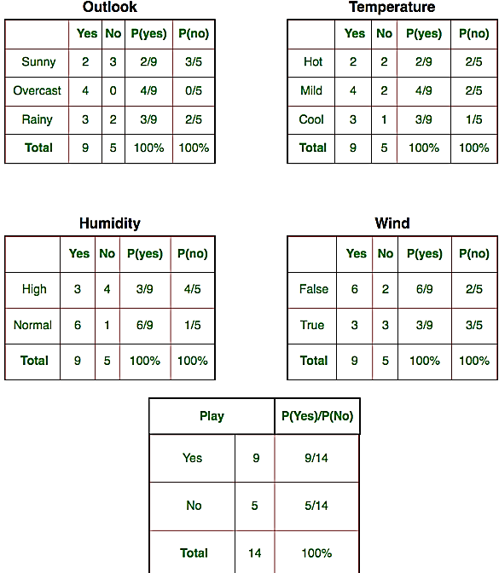
Naive assumption Example 3
Let us try to apply the Naive formula manually on our weather dataset.
For example, probability of playing golf given that the temperature is cool, i.e P(temp. = cool | play golf = Yes) = 3/9.
Also, we need to find class probabilities (P(y)) which has been calculated in the table 5. For example, P(play golf = Yes) = 9/14.
 | Yes | No | P(Yes) | P(No)
Sunny | 3 | 2 | 3/9 | 2/5
Overcast | 4 | 0 | 4/9 | 0/5
Rainy | 2 | 3 | 2/9 | 3/5
Total | 9 | 5 | 100% | 100%

Slide 29
Naive assumption
So now, we are done with our pre-computations and the classifier is ready!
Let us test it on a new set of features (let us call it today):
today = (Sunny, Hot, Normal, False)
So, probability of playing golf is given by:
and probability to not play golf is given by:

Slide 30
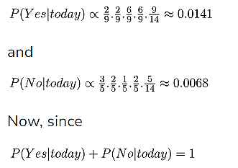
Naive assumption
Since, P(today) is common in both probabilities, we can ignore P(today) and find proportional probabilities as:

Slide 31
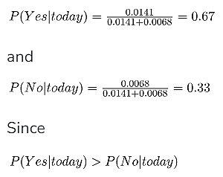
Naive assumption
These numbers can be converted into a probability by making the sum equal to 1 (normalization):
So, prediction that golf would be played is ‘Yes’.
The method that we discussed above is applicable for discrete data. In case of continuous data, we need to make some assumptions regarding the distribution of values of each feature. The different naive Bayes classifiers differ mainly by the assumptions they make regarding the distribution of P(x_{i} | y).

Slide 32
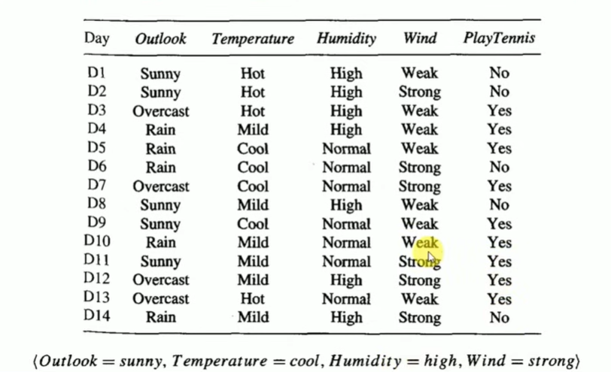

Slide 33
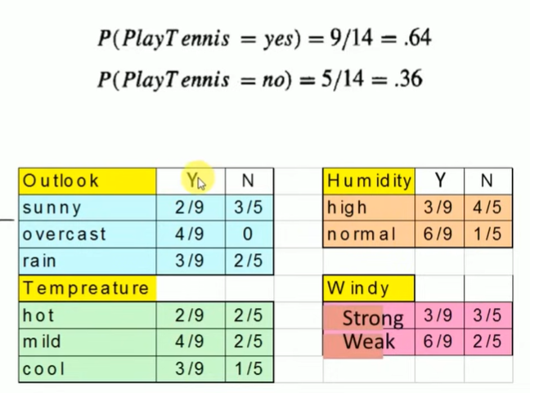

Slide 34
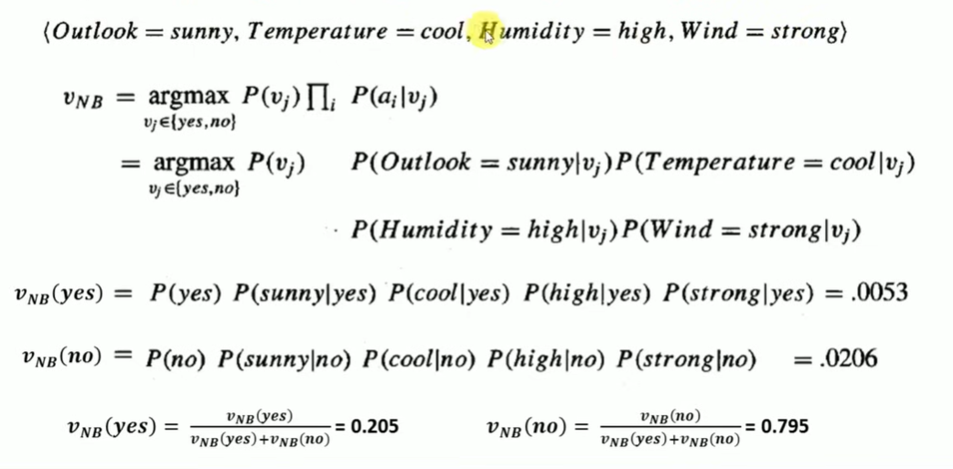
which has higher probability.
So will not go to play

Slide 35
Problem: If the weather is sunny, then the Player should play or not?
Solution: To solve this, first consider the below dataset:
Outlook | Play
0 | Rainy | Yes
1 | Sunny | Yes
2 | Overcast | Yes
3 | Overcast | Yes
4 | Sunny | No
5 | Rainy | Yes
6 | Sunny | Yes
7 | Overcast | Yes
8 | Rainy | No
9 | Sunny | No
10 | Sunny | Yes
11 | Rainy | No
12 | Overcast | Yes
13 | Overcast | Yes

Slide 36
Frequency table for the Weather Conditions:
Likelihood table weather condition:
Weather | Yes | No
Overcast | 5 | 0
Rainy | 2 | 2
Sunny | 3 | 2
Total | 10 | 4
Weather | No | Yes
Overcast | 0 | 5 | 5/14= 0.35
Rainy | 2 | 2 | 4/14=0.29
Sunny | 2 | 3 | 5/14=0.35
All | 4/14=0.29 | 10/14=0.71

Slide 37
Applying Bayes'theorem:
P(Yes|Sunny)= P(Sunny|Yes)*P(Yes)/P(Sunny)
P(Sunny|Yes)= 3/10= 0.3
P(Sunny)= 0.35
P(Yes)=0.71
So P(Yes|Sunny) = 0.3*0.71/0.35= 0.60
P(No|Sunny)= P(Sunny|No)*P(No)/P(Sunny)
P(Sunny|NO)= 2/4=0.5
P(No)= 0.29
P(Sunny)= 0.35
So P(No|Sunny)= 0.5*0.29/0.35 = 0.41
So as we can see from the above calculation that P(Yes|Sunny)>P(No|Sunny)
Hence on a Sunny day, Player can play the game.

Slide 38
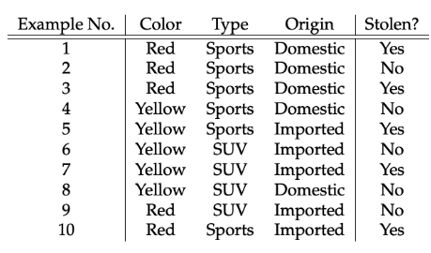
Let us take an example to get some better intuition. Consider the car theft problem with attributes Color, Type, Origin, and the target, Stolen can be either Yes or No. we need to classify whether the car is stolen, given the features of the car.
The columns represent these features and the rows represent individual entries. If we take the first row of the dataset, we can observe that the car is stolen if the Color is Red, the Type is Sports and Origin is Domestic. So we want to classify a Red Domestic SUV is getting stolen or not. Note that there is no example of a Red Domestic SUV in our data set.

Slide 39
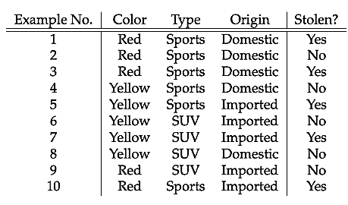

Slide 40
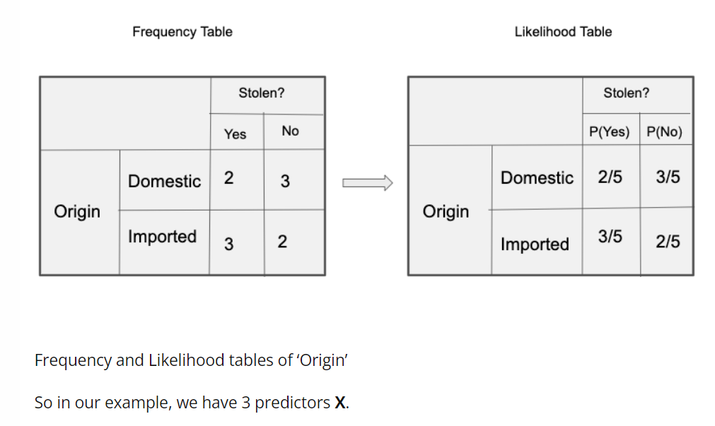
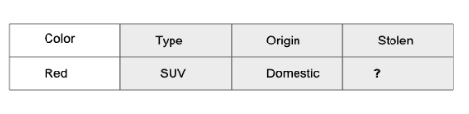

Slide 41
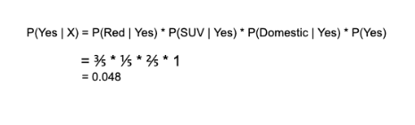
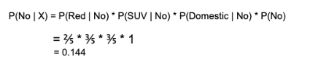
Correct the error
Since 0.144 > 0.048, Which means given the features RED SUV and Domestic, our example gets classified as ’NO’ the car is not stolen.
Notes:
https://monkeylearn.com/blog/practical-explanation-naive-bayes-classifier/
https://towardsdatascience.com/the-naive-bayes-classifier-how-it-works-e229e7970b84

Slide 42
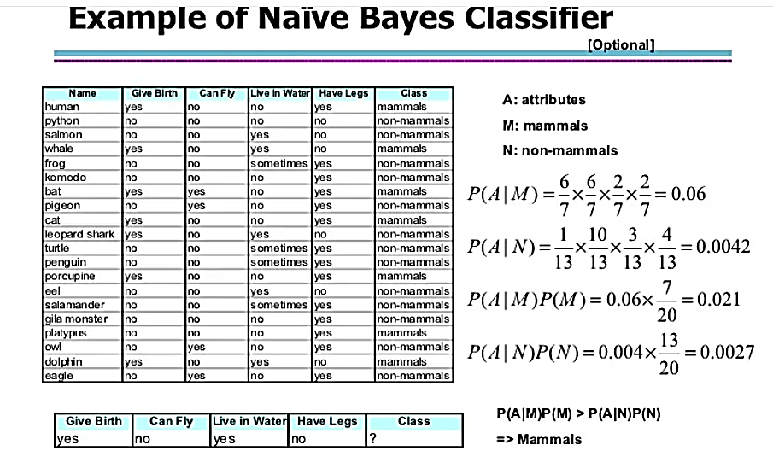

Slide 43
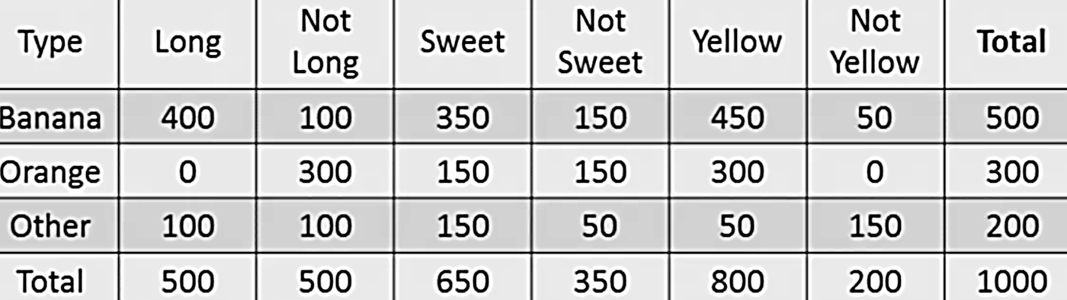
For the sake of computing the probabilities, let’s aggregate the training data to form a counts table like this.
So the objective of the classifier is to predict if a given fruit is a ‘Banana’ or ‘Orange’ or ‘Other’ when only the 3 features (long, sweet and yellow) are known.
Let’s say you are given a fruit that is: Long, Sweet and Yellow, can you predict what fruit it is?

Slide 44
Step 1: Compute the ‘Prior’ probabilities for each of the class of fruits. That is, the proportion of each fruit class out of all the fruits from the population.
You can provide the ‘Priors’ from prior information about the population. Otherwise, it can be computed from the training data. For this case, let’s compute from the training data. Out of 1000 records in training data, you have 500 Bananas, 300 Oranges and 200 Others.
So the respective priors are 0.5, 0.3 and 0.2. P(Y=Banana) = 500 / 1000 = 0.50 P(Y=Orange) = 300 / 1000 = 0.30 P(Y=Other) = 200 / 1000 = 0.20
Step 2: Compute the probability of evidence that goes in the denominator. This is nothing but the product of P of Xs for all X. This is an optional step because the denominator is the same for all the classes and so will not affect the probabilities. P(x1=Long) = 500 / 1000 = 0.50 P(x2=Sweet) = 650 / 1000 = 0.65 P(x3=Yellow) = 800 / 1000 = 0.80

Slide 45
Step 3: Compute the probability of likelihood of evidences that goes in the numerator. It is the product of conditional probabilities of the 3 features. If you refer back to the formula, it says P(X1 |Y=k).
Here X1 is ‘Long’ and k is ‘Banana’.
That means the probability the fruit is ‘Long’ given that it is a Banana. In the above table, you have 500 Bananas. Out of that 400 is long.
So, P(Long | Banana) = 400/500 = 0.8. Here, I have done it for Banana alone.
Probability of Likelihood for Banana P(x1=Long | Y=Banana) = 400 / 500 = 0.80 P(x2=Sweet | Y=Banana) = 350 / 500 = 0.70 P(x3=Yellow | Y=Banana) = 450 / 500 = 0.90.
So, the overall probability of Likelihood of evidence for Banana = 0.8 * 0.7 * 0.9 = 0.504

Slide 46
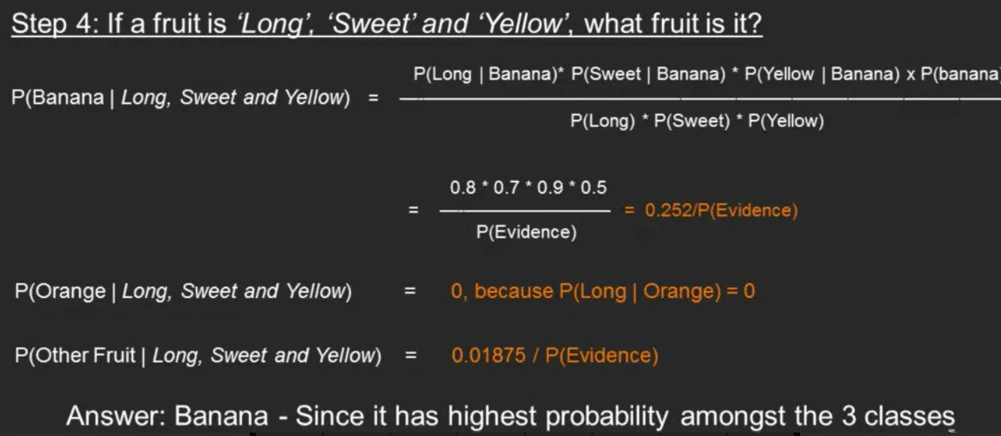
Step 4: Substitute all the 3 equations into the Naive Bayes formula, to get the probability that it is a banana.
Similarly, you can compute the probabilities for ‘Orange’ and ‘Other fruit’. The denominator is the same for all 3 cases, so it’s optional to compute. Clearly, Banana gets the highest probability, so that will be our predicted class.

Slide 47
Types of Naïve Bayes
There are three main types of Naïve Bayes which are listed below:
1. Gaussian Naïve Bayes
2. Multinomial Naïve Bayes
3. Bernoulli Naïve Bayes
In addition
Complement Naive Bayes
Categorical Naive Bayes

Slide 48
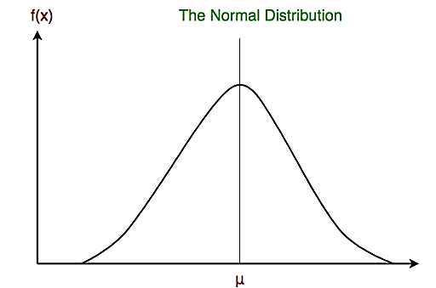
Gaussian Naive Bayes classifier
In Gaussian Naive Bayes, continuous values associated with each feature are assumed to be distributed according to a Gaussian distribution. Gaussian distribution is also called normal distribution. Normal distribution is a statistical model that describes the distributions of continuous random variables in nature and is defined by its bell-shaped curve.
The two most important features of the normal distribution are the mean (μ) and standard deviation (σ). The mean is the average value of a distribution, and the standard deviation is the “width” of the distribution around the mean.
A variable (X) that is normally distributed is distributed continuously (continuous variable) from −∞ < X < +∞, and the total area under the model curve is 1.
The attribute is first segmented based on the output class, and then the variance and mean of the attribute are calculated for each class.
The combination of the prediction for all parameters is the final prediction that returns a probability of the dependent variable to be classified in each group. The final classification is assigned to the group with the higher probability.
Notes:
gaussian is used in classification tasks and it assumes that feature values follow a gaussian distribution.

Slide 49
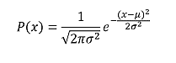
Gaussian Naive Bayes classifier
Gaussian naive Bayes is useful when working with continuous values whose probabilities can be modeled using a Gaussian distribution:
In the above formulae, sigma and mu is the variance and mean of the continuous variable X computed for a given class of Y.

Slide 50
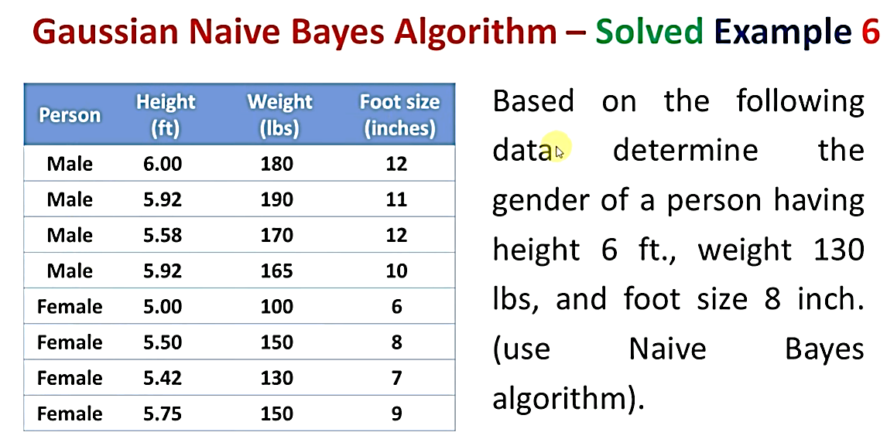

Slide 51
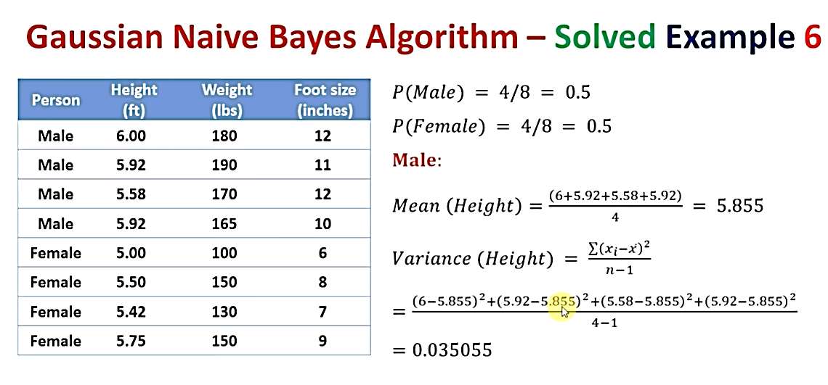
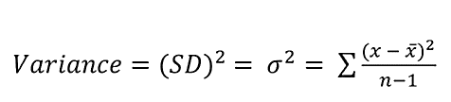

Slide 52
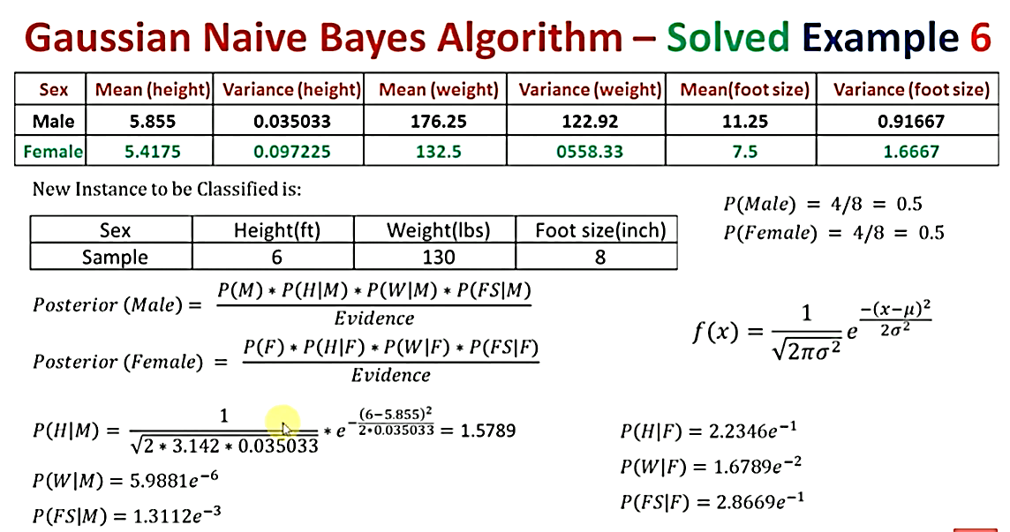
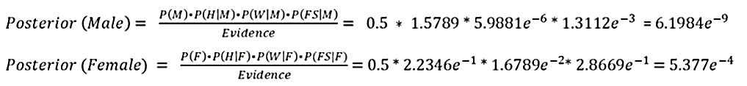


Slide 53
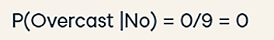
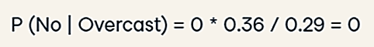
Laplace Smoothing
If the value of P(Long | Orange) is zero, that is, there is no ‘Long’ oranges in the training data then this will make P(Orange | Long, Sweet and Yellow) equal to zero. This is the problem of zero probability.
So, how to deal with this problem?
Laplace smoothing is a smoothing technique that handles the problem of zero probability in Naïve Bayes
To avoid this, we increase the count of the variable with zero to a small value (usually 1) in the numerator, so that the overall probability doesn’t become zero. This approach is called ‘Laplace Correction’ or Laplace Smoothing
Now we will solve the following zero probability problem using Laplace Smoothing technique.
.

Slide 54
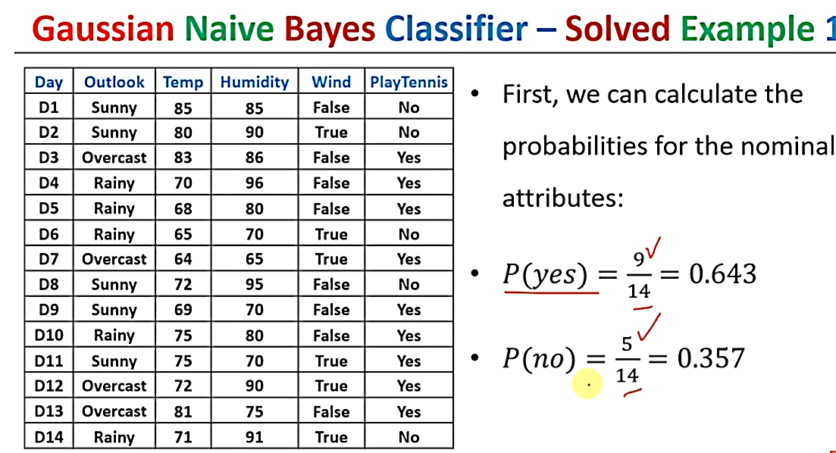

Slide 55
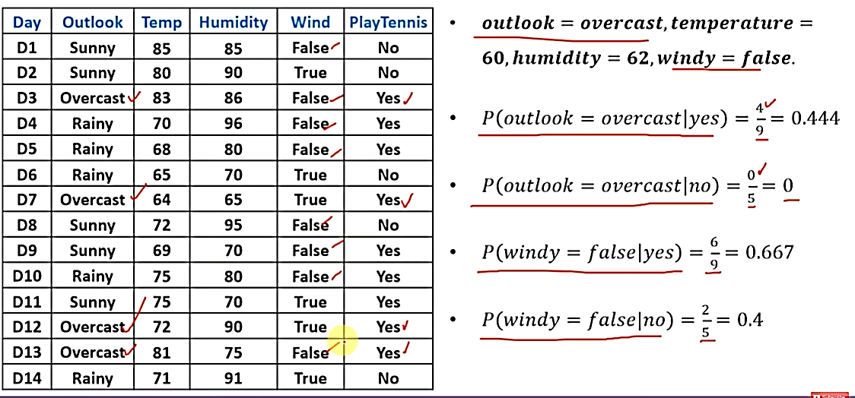

Slide 56
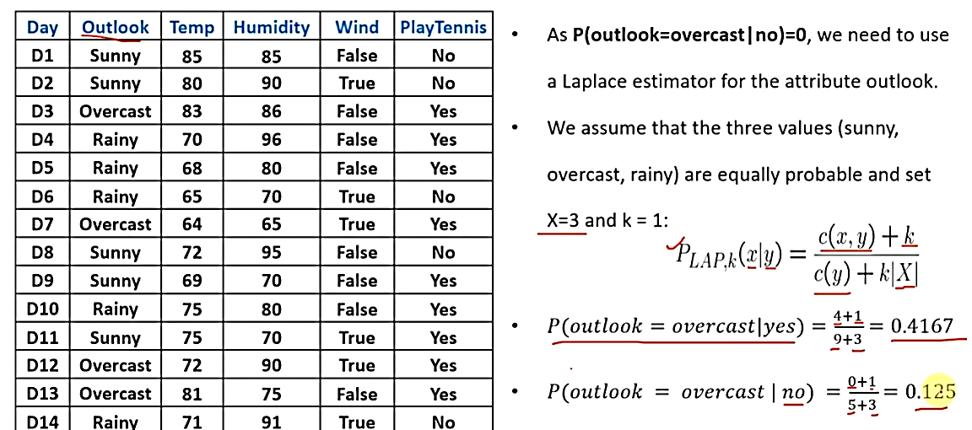

Slide 57
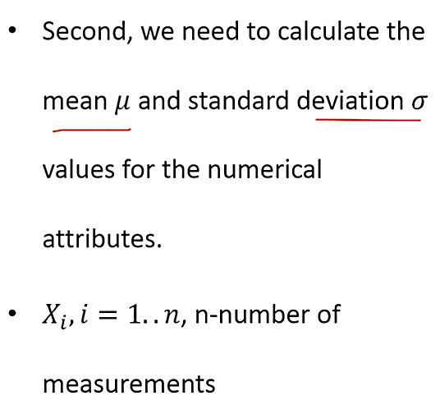
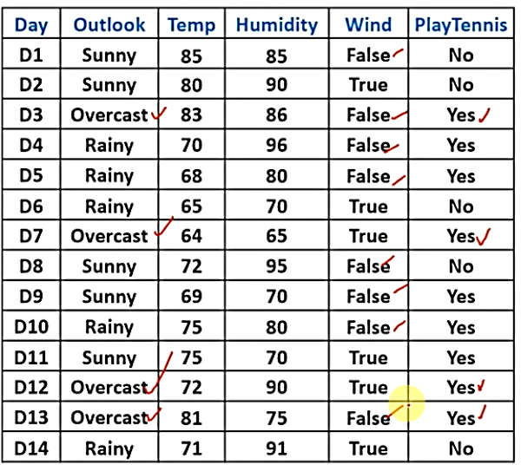

Slide 58


Slide 59


Slide 60


Slide 61




0.007

Slide 62


Slide 63
Multinomial Naive Bayes
Feature vectors represent the frequencies with which certain events have been generated by a multinomial distribution. This is the event model typically used for document classification/text classification.

Slide 64






Feature vectors represent the frequencies with which certain events have been generated by a multinomial distribution. This is the event model typically used for document classification/text classification.

Slide 65
Multinomial Naive Bayes
P(positive | overall liked the movie) = P(overall liked the movie | positive) * P(positive) / P(overall liked the movie)
Text | Reviews
“I liked the movie” | positive
“It’s a good movie. Nice story” | positive
“Nice songs. But sadly boring ending. ” | negative
“Hero’s acting is bad but heroine looks good. Overall nice movie” | positive
“Sad, boring movie” | negative

Slide 66
Multinomial Naive Bayes
Calculating probabilities: First, we calculate the a priori probability of each tag: for a given sentence in our training data, the probability that it is positive P(positive) is 3/5. Then, P(negative) is 2/5. Then, calculating P(overall | positive) means counting how many times the word “overall” appears in positive texts (1) divided by the total number of words in positive (17). Therefore, P(overall | positive) = 1/17, P(liked/positive) = 1/17, P(the/positive) = 2/17, P(movie/positive) = 3/17. If probability comes out to be zero then By using Laplace smoothing: we add 1 to every count so it’s never zero. To balance this, we add the number of possible words to the divisor, so the division will never be greater than 1. In our case, the total possible words count are 21.

Slide 67
Multinomial Naive Bayes
Applying smoothing, The results are:
Now we just multiply all the probabilities, and see who is bigger:
P(overall | positive) * P(liked | positive) * P(the | positive) * P(movie | positive) * P(positive ) = 1.38 * 10^{-5} = 0.0000138 P(overall | negative) * P(liked | negative) * P(the | negative) * P(movie | negative) * P(negative) = 0.13 * 10^{-5} = 0.0000013
Our classifier gives “overall liked the movie” the positive tag.
Word | P(word | positive) | P(word | negative)
overall | (1 + 1)/(17 + 21) | (0 + 1)/(7 + 21)
liked | (1 + 1)/(17 + 21) | (0 + 1)/(7 + 21)
the | (2 + 1/17 + 21) | (0 + 1)/(7 + 21)
movie | (3 + 1)/(17 + 21) | (1 + 1)/(7 + 21)

Slide 68


Bernoulli Naive Bayes
In Bernoulli Naïve Bayes algorithm, the features are distributed according to multivariate Bernoulli distributions. This means that there may be multiple features, but each one will be an independent Boolean variable. Hence, it requires the samples to be binary-values. Similar to the multinomial algorithm, the Bernoulli algorithm is popular for text classification, where binary term occurrences are used in place of term frequencies (i.e. frequency of a word in the document).
If X is random variable and is Bernoulli-distributed, it can assume only two values (for simplicity, let's call them 0 and 1) and their probability is:

Slide 69
Bernoulli Naive Bayes
Bernoulli Naive Bayes is a subcategory of the Naive Bayes Algorithm. It is used for the classification of binary features such as ‘Yes’ or ‘No’, ‘1’ or ‘0’, ‘True’ or ‘False’ etc. Here it is to be noted that the features are independent of one another. Bernoulli Naive Bayes is basically used for spam detection, text classification, Sentiment Analysis, used to determine whether a certain word is present in a document or not. The decision rule of Bernoulli NB is given as follows
Here, p(x_{i} |y) is the conditional probability of x_{i} occurring provided y has occurred.
i is the event
x_{i} holds binary value either 0 or 1

Slide 70


Slide 71
Bernoulli Naive Bayes
Step by step approach:
Consider the above dataset showing the result whether a person is pass or fail in the exam based on various outputs, I have considered a small one for better understanding. And we want to classify an instance 'X' with Confident=Yes, Studied=Yes and Sick=No
So, first we need to calculate the class probabilities i.e P(Pass)=3/5 and P(Fail)=2/5
Now we need to calculate individual probbaility wit respect to each features. For example, P(Confident=Yes| Result=Pass) = 2/3 P(Studied=Yes| Result=Pass) = 2/3 P(Sick=Yes| Result=Pass) = 1/3
Similarly,
P(Confident=Yes| Result=Fail) = 1/2 P(Studied=Yes| Result=Fail) = 1/2 P(Sick=Yes| Result=Fail) = 1/2

Slide 72
Bernoulli Naive Bayes
Now we calculate,
P(X|Result=Pass)xP(Result=Pass) = (2/3) * (2/3) * (1/3) * (3/5) = 0.088 P(X|Result=Fail)xP(Result=Fail) = (1/2) * (1/2) * (1/2) * (2/5) = 0.05
Next step is to calculate the probability of estimator P(X) = P(Confident=Yes)xP(Studied=Yes)xP(Sick=No) = (3/5) * (3/5) * (2/5) = 0.144
Finally, P(Result=Pass|X) = 0.088/0.144 = 0.611 P(Result=Fail|X) = 0.05/0.144 = 0.34
As 0.611>0.31, the instnace with 'Confident=Yes, Studied=Yes and Sick=No' has result as 'Pass'.

Slide 73
Bernoulli Naive Bayes
Let us consider the example below to understand Bernoulli Naive Bayes:-
In the above dataset, we are trying to predict whether a person has a disease or not based on their age, gender, and fever. Here, ‘Disease’ is the target, and the rest are the features.
All values are binary.
Adult | Gender | Fever | Disease
Yes | Female | No | False
Yes | Female | Yes | True
No | Male | Yes | False
No | Male | No | True
Yes | Male | Yes | True

Slide 74
Bernoulli Naive Bayes
We wish to classify an instance ‘X’ where Adult=’Yes’, Gender= ‘Male’, and Fever=’Yes’.
Firstly, we calculate the class probability, probability of disease or not.
P(Disease = True) = ⅗
P(Disease = False) = ⅖
Secondly, we calculate the individual probabilities for each feature.
P(Adult= Yes | Disease = True) = ⅔
P(Gender= Male | Disease = True) = ⅔
P(Fever= Yes | Disease = True) = ⅔

Slide 75
Bernoulli Naive Bayes
P(Adult= Yes | Disease = False) = ½
P(Gender= Male | Disease = False) = ½
P(Fever = Yes | Disease = False) = ½
Now, we need to find out two probabilities:-
(i) P(Disease= True | X) = (P(X | Disease= True) * P(Disease=True))/ P(X)
(ii) P( Disease = False | X) = (P(X | Disease = False) * P(Disease= False) )/P(X)
P(Disease = True | X) = (( ⅔ *⅔ * ⅔ ) * (⅗))/P(X) = (8/27 * ⅗) / P(X) = 0.17/P(X)
P(Disease = False | X) = [(½ * ½ * ½ ) * (⅖)] / P(X) = [⅛ * ⅖] / P(X) = 0.05/ P(X)

Slide 76
Bernoulli Naive Bayes
Now, we calculate estimator probability:-
P(X) = P(Adult= Yes) * P(Gender = Male ) * P(Fever = Yes)
= ⅗ * ⅗ * ⅗ = 27/125 = 0.21
So we get finally:-
P(Disease = True | X) = 0.17 / P(X)
= 0.17 / 0.21
= 0.80 - (1)
P(Disease = False | X) = 0.05 / P(X)
= 0.05 / 0.21
= 0.23 - (2)
Now, we notice that (1) > (2), the result of instance ‘X’ is ‘True’, i.e., the person has the disease.

Slide 77
Thank You

Slide 78
Example
Using the data, we have to identify the species of an entity with the following attributes.
X={Color=Green, Legs=2, Height=Tall, Smelly=No}
To predict the class label for the above attribute set, we will first calculate the probability of the species being M or H in total.
P(Species=M)=4/8=0.5 P(Species=H)=4/8=0.5
Next, we will calculate the conditional probability of each attribute value for each class label.
P(Color=White/Species=M)=2/4=0.5 P(Color=White/Species=H)=¾=0.75 P(Color=Green/Species=M)=2/4=0.5 P(Color=Green/Species=H)=¼=0.25 P(Legs=2/Species=M)=1/4=0.25 P(Legs=2/Species=H)=4/4=1 P(Legs=3/Species=M)=3/4=0.75 P(Legs=3/Species=H)=0/4=0 P(Height=Tall/Species=M)=3/4=0.75 P(Height=Tall/Species=H)=2/4=0.5 P(Height=Short/Species=M)=1/4=0.25 P(Height=Short/Species=H)=2/4=0.5 P(Smelly=Yes/Species=M)=3/4=0.75 P(Smelly=Yes/Species=H)=1/4=0.25 P(Smelly=No/Species=M)=1/4=0.25 P(Smelly=No/Species=H)=3/4=0.75
Sl. No. | Color | Legs | Height | Smelly | Species
1 | White | 3 | Short | Yes | M
2 | Green | 2 | Tall | No | M
3 | Green | 3 | Short | Yes | M
4 | White | 3 | Short | Yes | M
5 | Green | 2 | Short | No | H
6 | White | 2 | Tall | No | H
7 | White | 2 | Tall | No | H
8 | White | 2 | Short | Yes | H

Slide 79
Example
We can tabulate the above calculations in the tables for better visualization.
The conditional probability table for the Color attribute is as follows.
The conditional probability table for the Legs attribute is as follows.
Color | M | H
White | 0.5 | 0.75
Green | 0.5 | 0.25
Legs | M | H
2 | 0.25 | 1
3 | 0.75 | 0

Slide 80
Example
The conditional probability table for the Height attribute is as follows.
The conditional probability table for the Smelly attribute is as follows.
Height | M | H
Tall | 0.75 | 0.5
Short | 0.25 | 0.5
Smelly | M | H
Yes | 0.75 | 0.25
No | 0.25 | 0.75

Slide 81
Example
Now that we have calculated the conditional probabilities, we will use them to calculate the probability of the new attribute set belonging to a single class.
Let us consider X= {Color=Green, Legs=2, Height=Tall, Smelly=No}.
Then, the probability of X belonging to Species M will be as follows.
P(M/X)=P(Species=M)*P(Color=Green/Species=M)*P(Legs=2/Species=M)*P(Height=Tall/Species=M)*P(Smelly=No/Species=M) =0.5*0.5*0.25*0.75*0.25 =0.0117
Similarly, the probability of X belonging to Species H will be calculated as follows.
P(H/X)=P(Species=H)*P(Color=Green/Species=H)*P(Legs=2/Species=H)*P(Height=Tall/Species=H)*P(Smelly=No/Species=H) =0.5*0.25*1*0.5*0.75 =0.0468
So, the probability of X belonging to Species M is 0.0117 and that to Species H is 0.0468. Hence, we will assign the entity X with attributes {Color=Green, Legs=2, Height=Tall, Smelly=No} to species H.

